Slide 1

Getting an Edge with Network Analysis in Python
A Gentle Introduction
Alon Nir
(@alonnir)
PyCon UK 2018
Cardiff City Hall
Notes:
Good morning everyone, thank you for coming
my name is Alon Nir and I’m a data scientist based in London
Today I’d like to give you a brief introduction to network analysis, both theoretical and practical

Slide 2
My Objectives for Today
Show you how useful network analysis can be
Show you how easy it is to get started
Notes:
25 minutes is not nearly enough to cover this topic, there have been introductory workshops to network analysis in previous confrences that took 3 hours..

Slide 3
Our Plan For Today
What we’ll do:
Brief theoretical intro
Analyse a real network with Python
Explore useful and interesting examples
Notes:
Vast over simplification

Slide 4
Our Plan For Today
What we won’t do:
In the interest of time we’ll touch just a few of the many (many!) things there’s to learn, just enough to get you started.
No mathematical formulations! No greek letters!
Dive deep into theory (Results are often intuitive but the algorithms to get them are not.)
Links to (excellent!) further resources will be provided.
Notes:
Vast over simplification

Slide 5

What Is a Network Anyway?
And why should we care?

Slide 6
Why Should We Care?
Networks are everywhere, and they affect our lives daily.
As we’ll see later, some examples include:
Finding a job
Finding a spouse
Finding anything on Google
Detecting bot/troll networks on Twitter
Deciding which banks to bail out during a financial crisis
Personalised recommendations
Surviving a zombie outbreak

Slide 7
What Wikipedia Has to Say
In one very common sense of the term, a graph is an ordered pair G = (V, E) comprising a set V of vertices, nodes or points together with a set E of edges, arcs or lines, which are 2-element subsets of V (i.e., an edge is associated with two vertices, and the association takes the form of the unordered pair of the vertices). To avoid ambiguity, this type of graph may be described precisely as undirected and simple.
Other senses of graph stem from different conceptions of the edge set. In one more general conception, E is a set together with a relation of incidence that associates with each edge two vertices. In another generalized notion, E is a multiset of unordered pairs of (not necessarily distinct) vertices. Many authors call these types of object multigraphs or pseudographs.
Source:
https://en.wikipedia.org/wiki/Graph_(discrete_mathematics)

Slide 8
Watered Down Definition
KISS
points and lines.
If you can draw a conceptual relationship between two objects, it’s likely you can model the objects as a graph.
Notes:
Vast over simplification

Slide 9
Points and Lines
Points | Lines
People | Friendships, following
Companies | Trade, acquire
Bus stops | Buses, passengers
Ubers/Lyfts/Ofo bikes | Passengers/riders
Countries | Trade, flight routes, Eurovision points
Wikipedia articles | Internal links
Notes:
Vast over simplification

Slide 10

Obvious Example - Facebook
Notes:
The most straightforward example is of course facebook.

Slide 11

Obvious Example - Facebook

Slide 12
Obvious Example - Facebook

Slide 13

Obvious Example - Facebook

Slide 14





Obvious Example - Facebook

Slide 15
Points and Lines
Points and Lines have more formal names, which vary by discipline
Points | Lines | Discipline
Nodes | Edges, Links | Computer Science
Vertices | Edges, Arcs | Math
Sites | Bonds | Physics
Actors | Ties, Relations | Sociology
Source:
Jean Mark Gawron, Python for Social Science, https://gawron.sdsu.edu/python_for_ss/course_core/book_draft/Social_Networks/Social_Networks.html#what-are-networks

Slide 16
Points and Lines
Points and Lines have more formal names, which vary by discipline
Points | Lines | Discipline
Nodes | Edges, Links | Computer Science
Vertices | Edges, Arcs | Math
Sites | Bonds | Physics
Actors | Ties, Relations | Sociology
Source:
Jean Mark Gawron, Python for Social Science, https://gawron.sdsu.edu/python_for_ss/course_core/book_draft/Social_Networks/Social_Networks.html#what-are-networks

Slide 17
Main Types of Networks
UnDirected |  | Directed
Facebook Linkedin Connections are directionless and reciprocal |  | Twitter Snaphchat Instagram Whateverkidsusenowadays Connections don’t have to be reciprocal - if A follows B on Twitter, B does not necessarily follow A
Also: MultiGraph and Multi-Directed-Graph

Slide 18
Main Types of Networks
Multigraph |  | Weighted
Nodes can have more than one edge between them. e.g. messages on whatsapp (and multi-directed-graph) |  | The connection (the edge) can be quantifiable and different from edge to edge. e.g. sending p2p payments for varying amounts.

Slide 19
Network Analysis in Python
The best way to learn is to get our hands dirty with real data and work out an example, so…
pip install networkx

Slide 20
Network Analysis in Python
Why NetworkX?
Comprehensive (mostly)
Friendly API
Good documentation
This is PyCon
Shortcomings
Scalability to very large graphs
Visualization of very large graphs
(other options: snap.py, graph-tool, iGraph and Gephi)

Slide 21
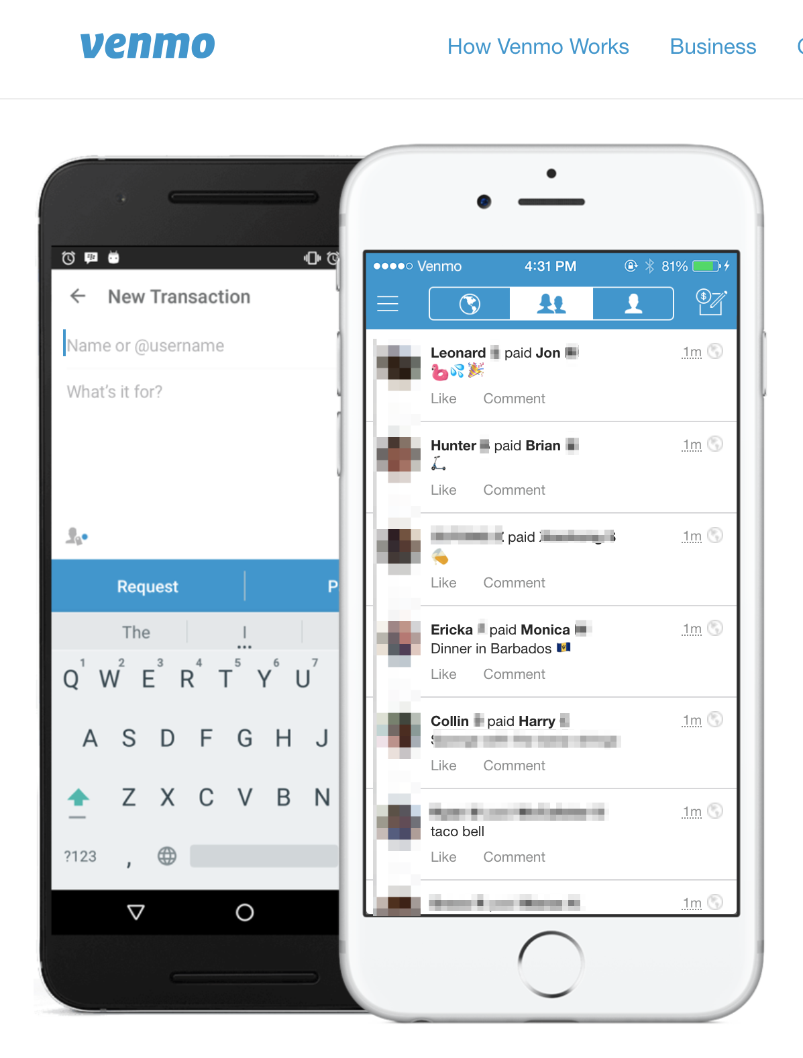
Example - Venmo
Link to
venmo.com
Notes:
Gif it ?
Explain what venmo is, what it does...

Slide 22
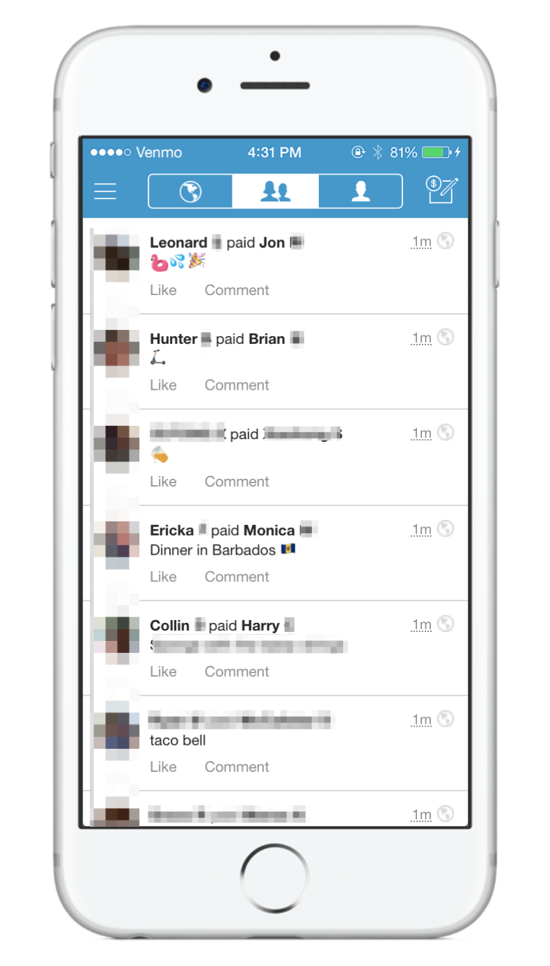
Example - Venmo
Leonard
Jon
Hunter
Brian
Ericka
Monica

Slide 23

Make Python Run Now

Slide 24

Some Examples

Slide 25
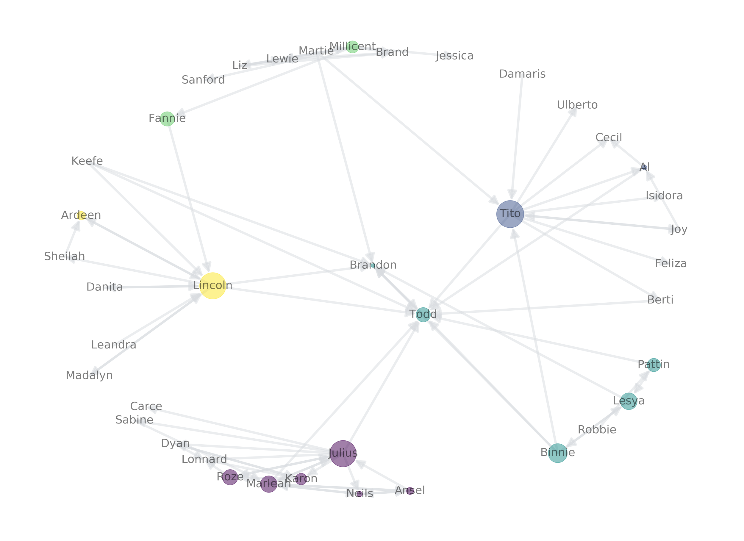
The Strength of Weak Ties
Strong ties
Seminal work by Mark Granovetter.
Cited 50K times!
Jobs
Spouses!
weak tie
weak tie
weak tie
See:
Stanford Center on Poverty and Inequality: Social Networks and Getting a Job: Mark Granovetter - link
Strong ties
Notes:
Very broadly the motivation here is that you know pretty much everything your friends know, so if you want to find job opportunities or dating opportunities you need to look at other groups. You can be introduced to other groups through your weak ties.

Slide 26
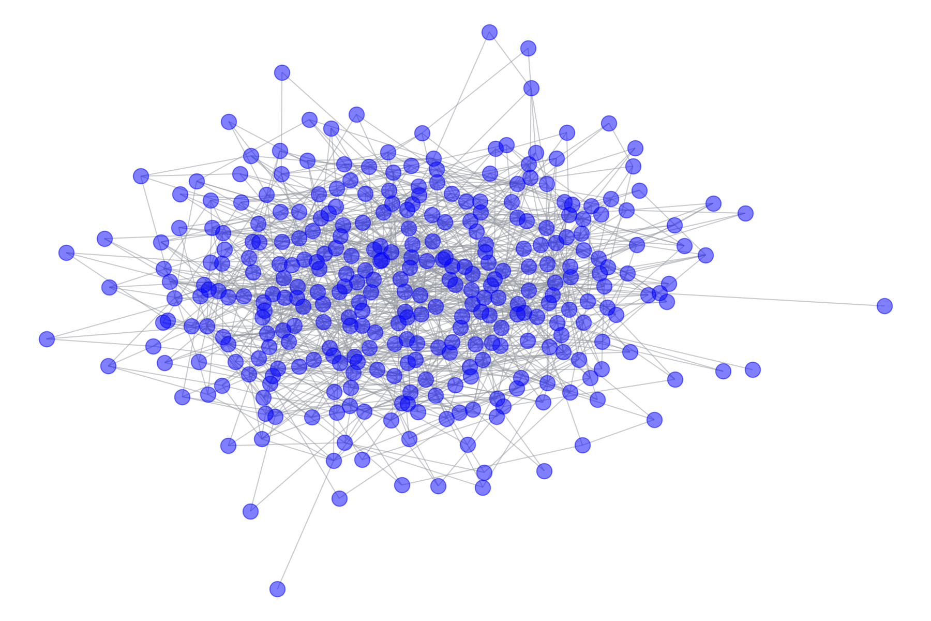
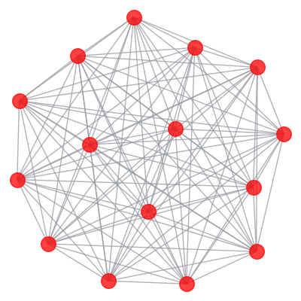
Reddit Karma Cheaters
Source:
Simulated data by me.
Conceptual source: Chris Slowe, Reddit’s CTO, in a SFU Data Science Talk, February 3rd 2018

Slide 27
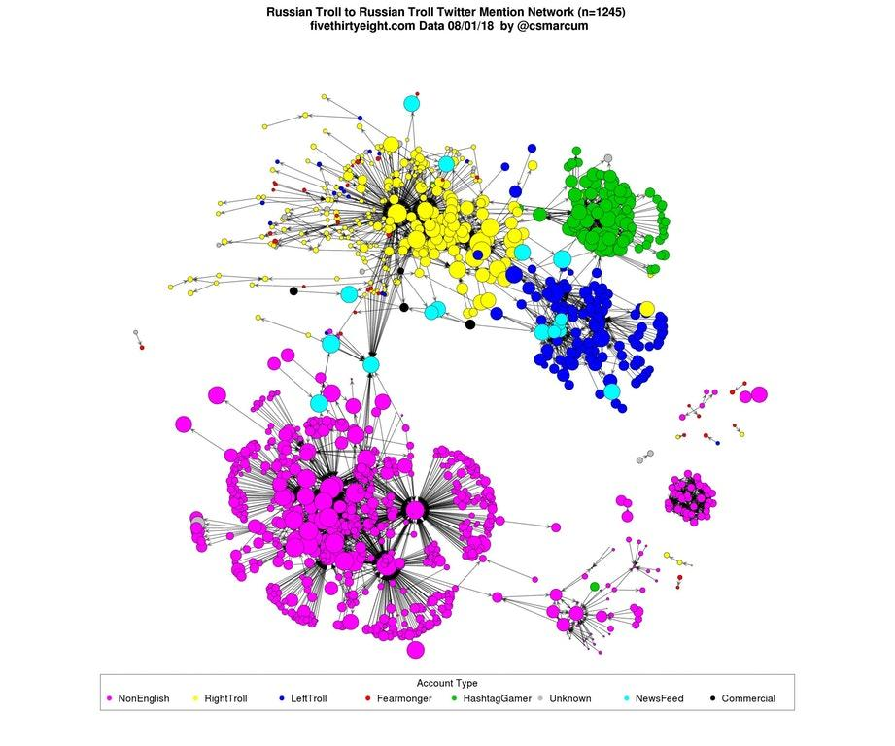
Twitter Bot Networks
Credit:
@csmarcum https://www.reddit.com/r/dataisbeautiful/comments/9436q2/russian_troll_2_russian_troll_twitter_mention/
FiveThirtyEight data - https://fivethirtyeight.com/features/why-were-sharing-3-million-russian-troll-tweets/

Slide 28
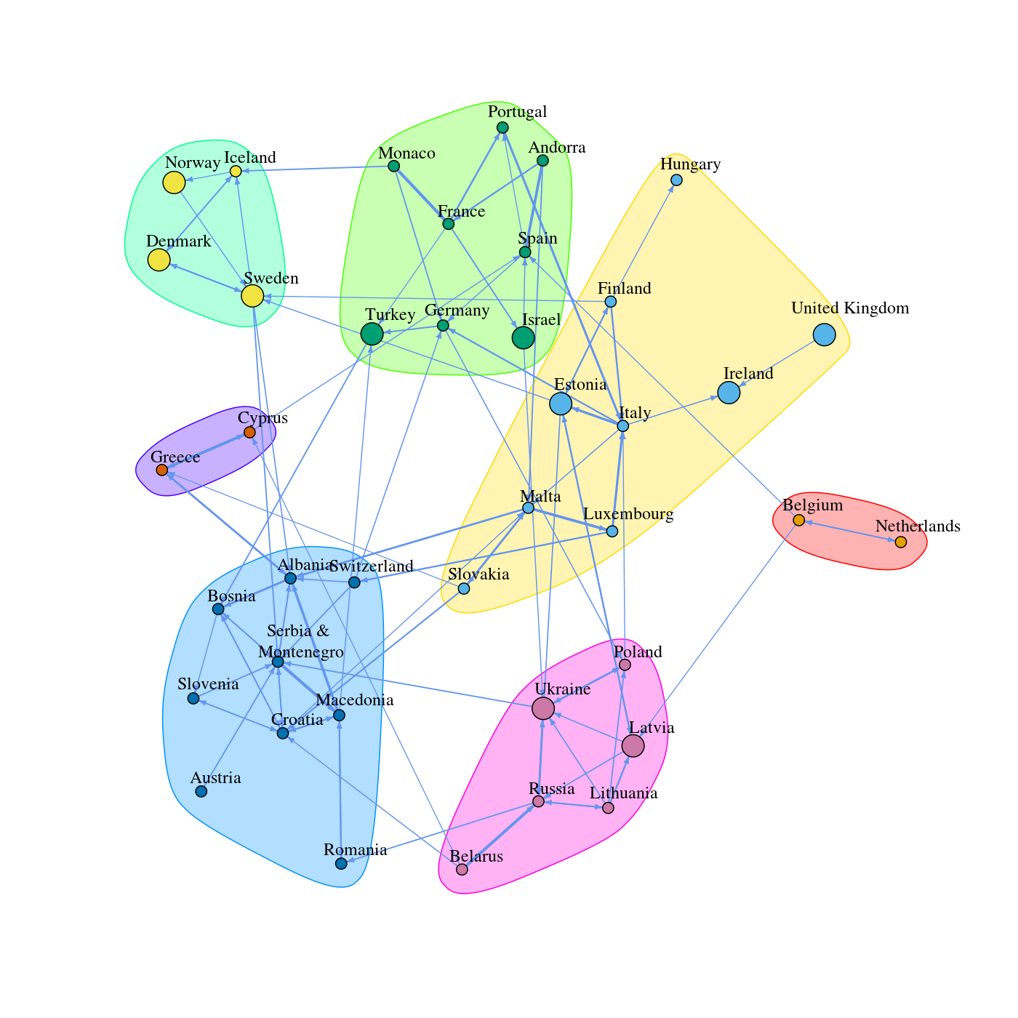
Eurovision Voting Examiner
Source: Overthinking It - Eurovision Voting Examiner

Slide 29
Gig Economy Categories
Categories as nodes, Customers that but more than one type of service as edges.
→ Bundles
SEO
Website set up
Logo Design
Content
creation
SEO

Slide 30
More...
Recommendations, clustering (bi-partite graphs, which we didn’t cover)
Complex contagion

Slide 31
Closing Remarks

Slide 32
Conclusion
Network analysis is a powerful, widely applicable tool.
We barely scratched the surface.
NetworkX is a great place to start.
<3 Python

Slide 33
Next Steps
Eric J. Ma - PyCon/PyData Workshops, DataCamp course.
Sara Guido - NetworkX Tutorial (watch out for version compatibility)
Vaidehi Joshi - A Gentle Introduction To Graph Theory
Awesome network analysis (resource list)
NetworkX Docs!

Slide 34
Thank You!
Let’s connect:
@alonnir

Slide 35
Homework Assignment

Slide 36
Discuss bridges,
Robustness
Disseminating info / contagion
Even paths?

Slide 37
לודא שכל המחברת רצה כמו שצריך אחרי שעושים ריסטארט לקרנל
גיבוי במצגות ו pdf !
לסגור מחברות אחרות ודברים אחרים כדי להקל על הזכרון

Slide 38
לשתף גם עם המחשב השני?!

Slide 39
Notes for me - do not publish
(Networks or graphs)
Source: https://github.com/jtorrents/pydata_bcn_NetworkX/blob/master/NetworkX_SNA_workshop_with_solutions.ipynb

Slide 40
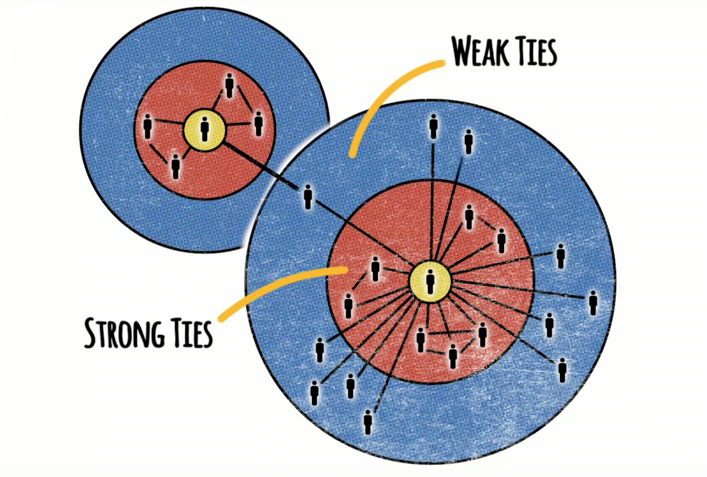
The Strength of Weak Ties
Seminal work by Mark Granovetter.
Cited 50K times!
Jobs
Spouses!
Source:
Stanford Center on Poverty and Inequality: Social Networks and Getting a Job: Mark Granovetter - link
Notes:
Very broadly the motivation here is that you know pretty much everything your friends know, so if you want to find job opportunities or dating opportunities you need to look at other groups. You can be introduced to other groups through your weak ties.

Slide 41
try to visualize the large network with
https://stackoverflow.com/a/51535568
also:
https://stackoverflow.com/questions/7991138/how-do-i-visualize-social-networks-with-python

Slide 42
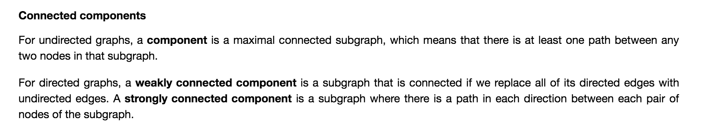
<too big - connected components>
Communities? Something else?
להראות פה דוגמא גרפית טיפשית מה זה CC

